Slide 1
Sogrape_Hackathon
Online Wine Price Harvesting Challenge

Slide 2
Problem at hands:
Tracking wine prices from different online stores in an effective manner
Approach:
Brainstorming all the possible scenarios for the final product
Choosing adequate tools for our project’s needs
Organizing the team by tasks
Web scraping
Database
Dashboard

Slide 3
Project Advantages:
User-friendly dashboard that can track all the desired wines
Simple and organized database (MySQL)
Evolution and history of wine prices
Strong base capable of adding features

Slide 4
Future implementations:
User login for data security
Management of user permissions
Improvement of the web scraping
Development of the graphical interface
Wine price changes notifications
Adaptability to scale for further demands

Slide 5
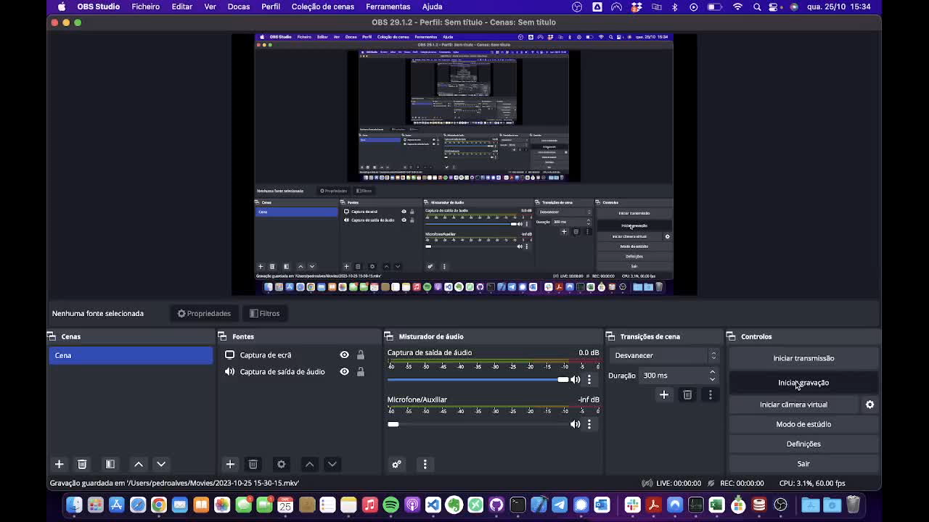
Web Scraping

Slide 6
Database
Prices:
price_id 🔑
price_value
discount
currency
timestamp
product_url
wine_id 🗝️
store_id 🗝️
Wines:
wine_id 🔑
wine_name
harvest_year
capacity
location
EAN
wine_image
Stores:
store_id 🔑
store_name
store_url
🔑: Primary key 🗝️: Foreign key

Slide 7
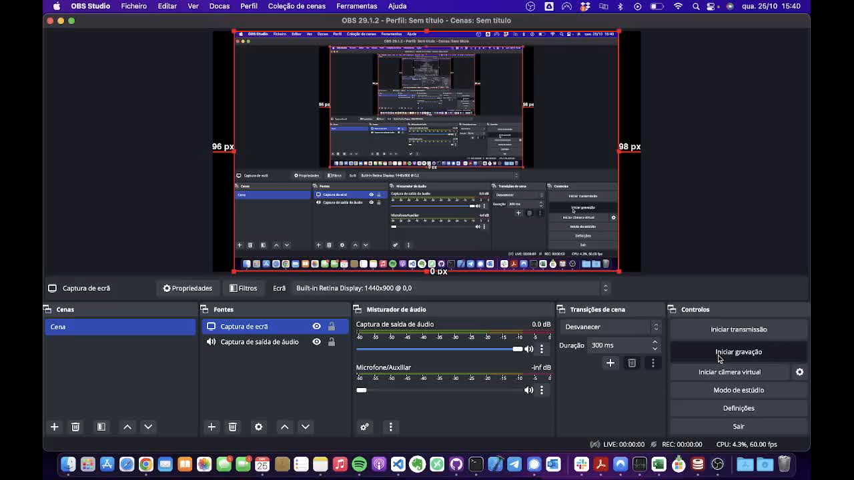
Dashboard

